Slide 1

PARC What’s all this about impedance matching?
Dave VE3OOI

Slide 2
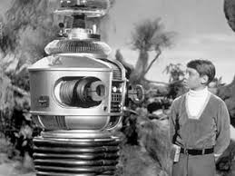
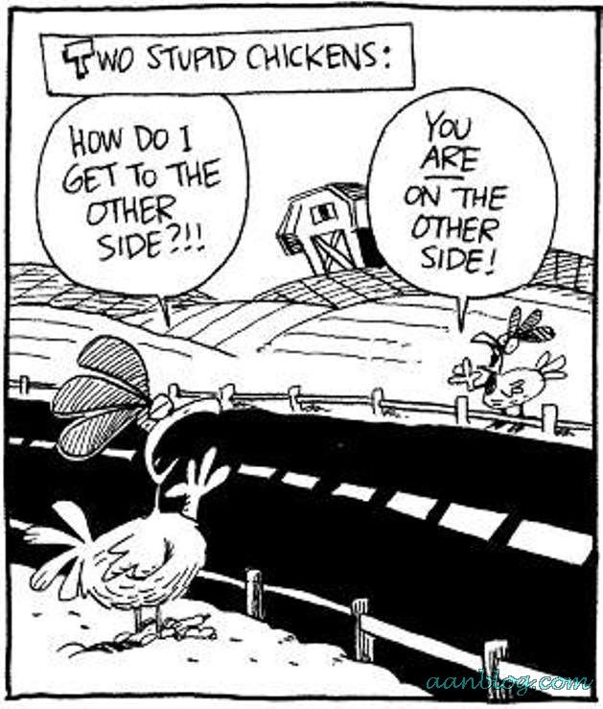
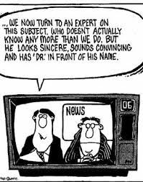
Danger will Robinson...

Slide 3

power transfer & signal reflection
Wikipedia
Impedance matching is the practice of designing the input impedance of an electrical load or the output impedance of its corresponding signal source to maximize the power transfer or minimize signal reflection from the load
Maximum Power Transfer
DC: Source Resistance is equal to Load Resistance
AC: Source Impedance is equal to conjugate Load Impedance at a frequency
For two impedances to be complex conjugates their resistances must be equal, and their reactances must be equal in magnitude but of opposite signs (i.e. capacitive = inductive or resonance)
In some cases, low source can drive a high impedance
e.g. opamp: higher voltage delivered without high power dissipation

Slide 4

HUH? DumB it DOWN
Resistive Source Driving a Complex Load

Slide 5
HUH? DumB it DOWN
Note:
-Reactance is Capacitive
+Reactance is Inductive
Introduce a Matching Device to Introduce the Complex Conjugate
At point A, R = R, +jX cancels –jX (Life is good)

Slide 6
ANTENNA RESONACE?
https://www.elprocus.com/

Slide 7
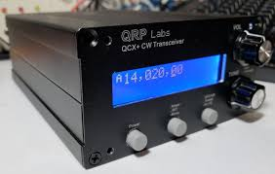
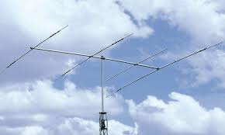
focus on maximum power transfer
MAX POWER
Ignore complex impedance mumbo jumbo

Slide 8
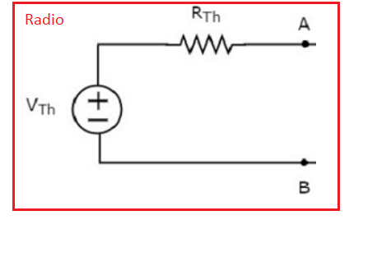

introduce SIMPLE RADIO
Radio output impedance is R_{th} = 50 Ohms

Slide 9

QUESTIONS?

Slide 10
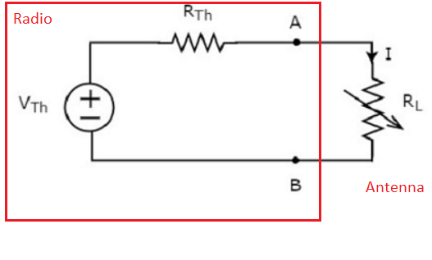
SIMPLE RADIO Connected TO SIMPLE ANTENNA

Slide 11
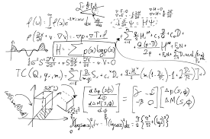
The DREADED MATH...
"Quod Erat Demonstrandum"

Slide 12
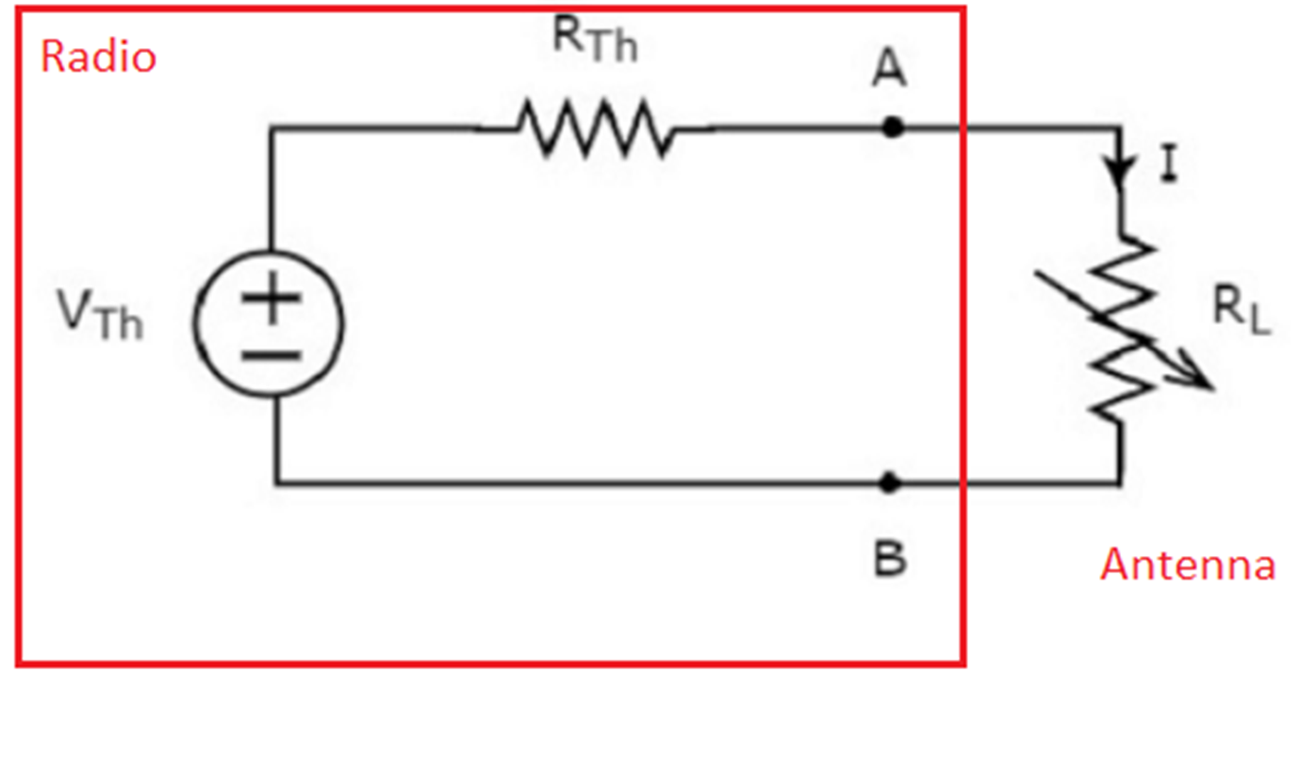
The DREADED MATH...
Same current flows through both resistors
Current will be Voltage divided by sum or both resistances
Power into “antenna” is I^2*R (I-squared R)
Did your brain melt?

Slide 13
PLOT the POWER FORMULA

Slide 14
QUESTIONS?
Use an Inductor or a Capacitor..

